Slide 1
A hands-on introduction to Multiple Point Statistics
Gregoire Mariethoz, Mathieu Gravey, Fabio Oriani
University of Lausanne, GAIA Lab

Slide 2
Context: dealing with data in geosciences
Main challenges:
Natural phenomena vary in space and in time
Data are typically incomplete
No matter how sophisticated the data acquisition methods
Examples:
Point data need to be interpolated on a grid
The available data are too coarse (need downscaling)
Data present spatial or temporal gaps (e.g. gaps in time series, holes in images)
Approach often used to deal with the lack of data: geostatistics.

Slide 3
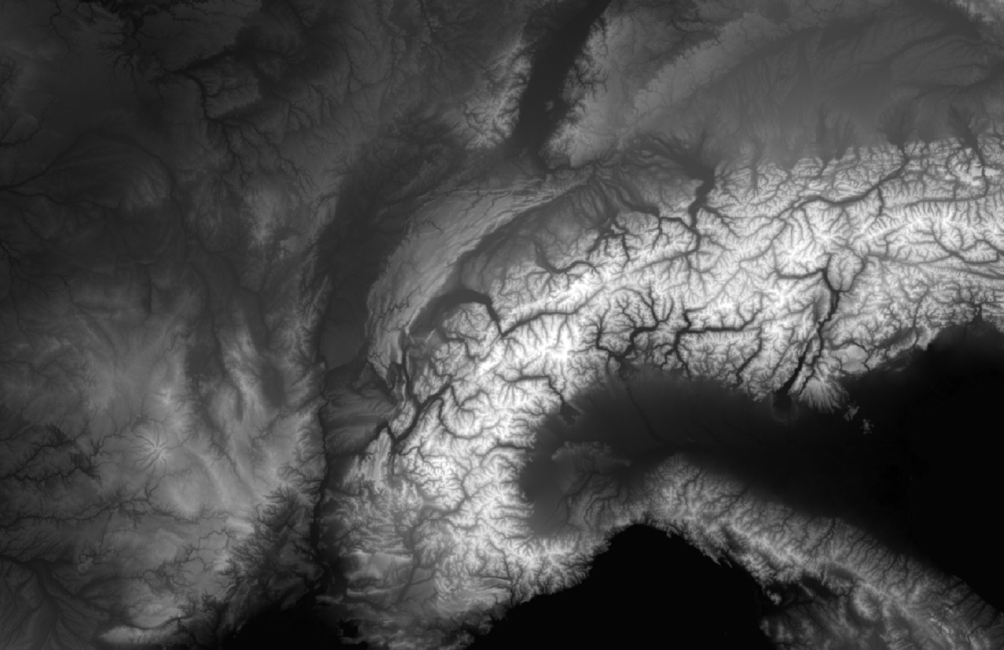
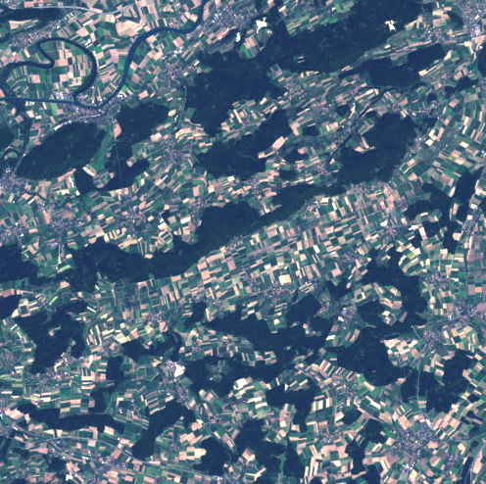
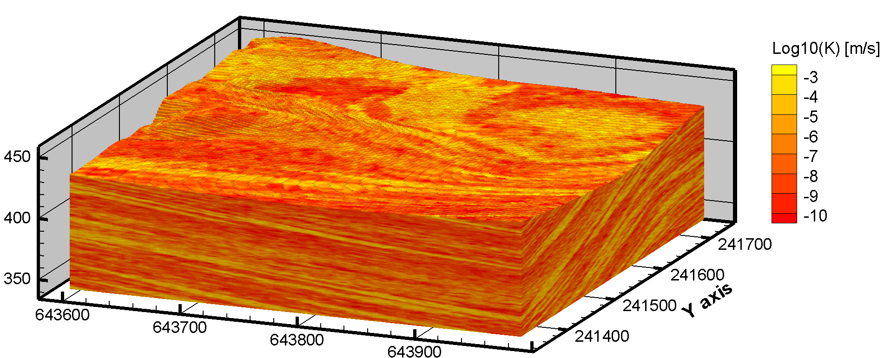
Many problems in geosciences: Strong spatial variability+lots of data

Slide 4
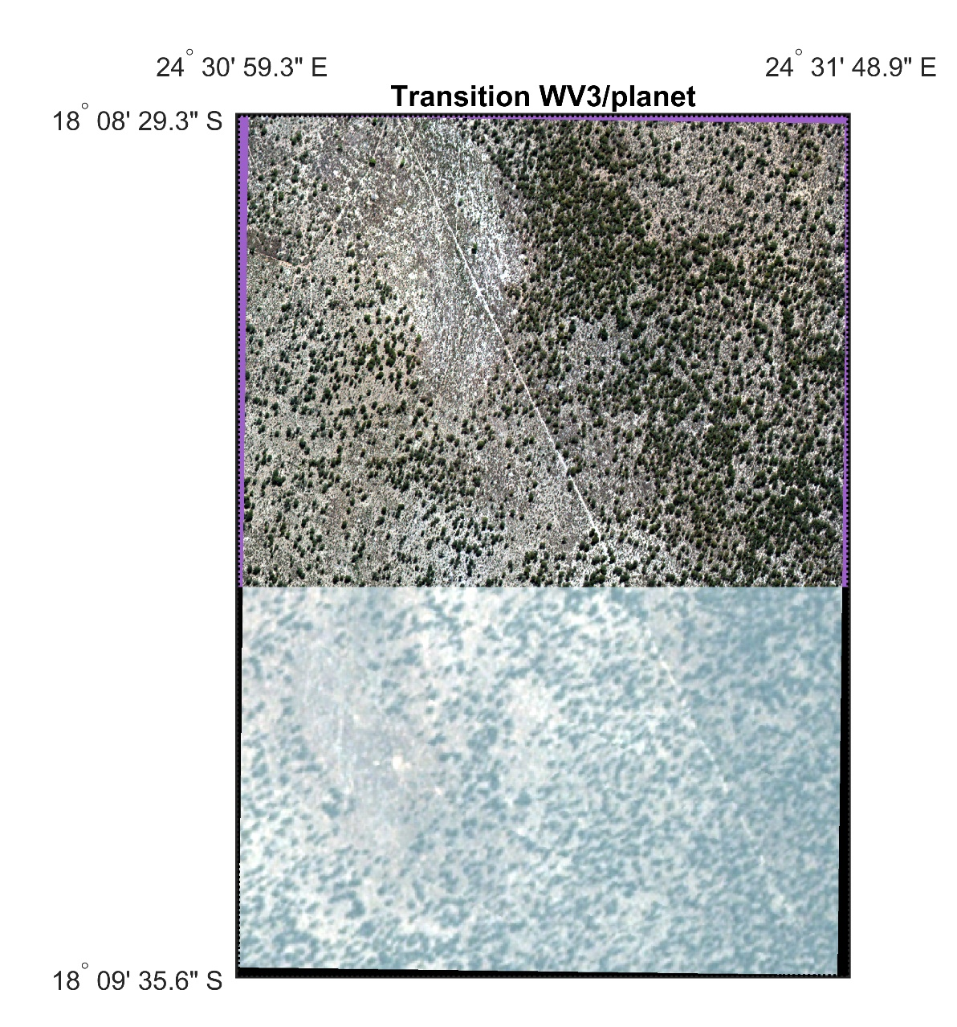
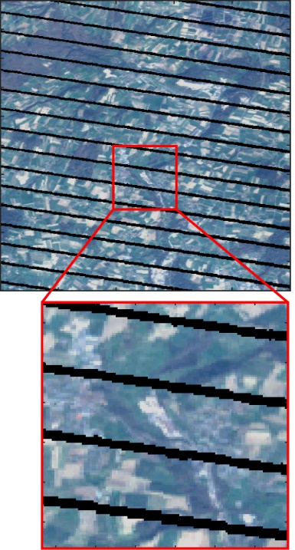
Some typical problems
Landsat 7 SLC-off gaps
Gap-filling
Data fusion/downscaling

Slide 5
Interpolation with lots of information
Lots of information: local, textural, etc.
Parametric models such as kriging are parsimonious (2-3 perameters).
This parsimony leads to information loss.
Main issue: the interpolated samples are only as rich as the model (thus poorer than the original data).

Slide 6
Training images in action
Generate spatially continuous textures, with correct statistics
Realization 1
Realization 2
Probability of encountering a channel (white)
Notes:
Here is an example with a training image corresponding to a remote sensing image of the Ganges delta.
It is used to build models that present the same spatial patterns and that respect given data.
Several models possible, thus allowing to quantify uncertainty.

Slide 7
Multiple-point geostatistics
Based on 3 main concepts:
When the features to model are too complex for parametric models, use non-parametric models.
Capturing complex features requires lots of data. When these data are not available, we can use analogues, which can be expressed as training images.
To capture complexity, it is not sufficient to look at the relationships between pairs of locations, but one should compare entire patterns.
First proposed in 1993:
Guardiano, F. and M. Srivastava (1993). Multivariate geostatistics: Beyond bivariate moments. Geostatistics-Troia. A. Soares. Dordrecht, Kluwier Academic. 1: 133-144.
The concept really became popular only 10-15 years later.

Slide 8
Pattern matching
Fundamental principle of multiple-point geostat: pattern matching.
Given a neighborhood pattern N_{x}, we look for a similar pattern N_{y} in the training image.
This is done using a distance or mismatch:
Repeat until a complete texturized image is generated.

Slide 9
The DS algorithm (not use today)
Simulation
neighborhood
Training image
Matches !
Copy the value
Doesn’t match
Doesn’t match
As soon as one good configuration is found,
the value at the central pixel is assigned to the simulated node.

Slide 10
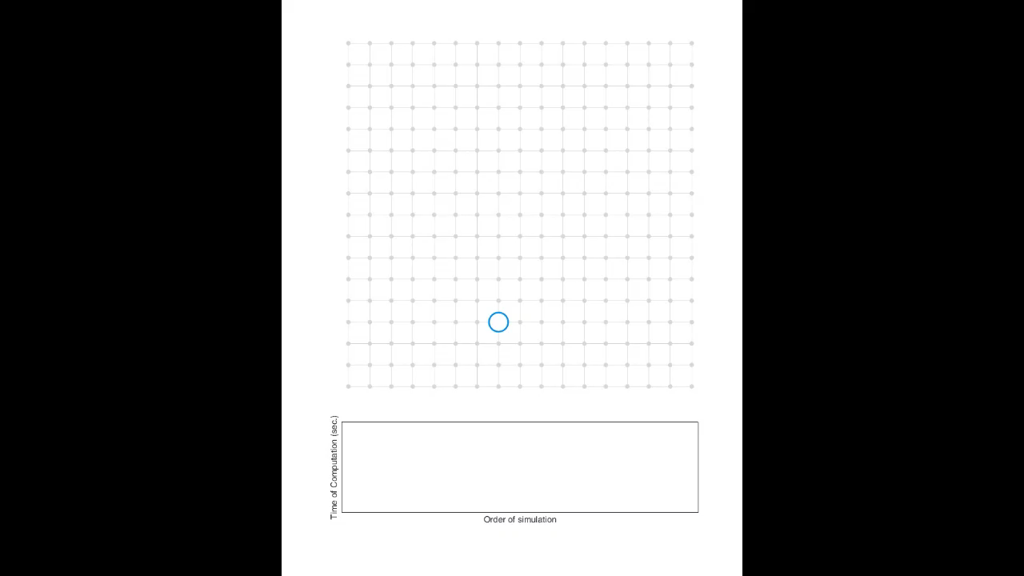
Sequential simulation
Video R. Nussbaumer

Slide 11
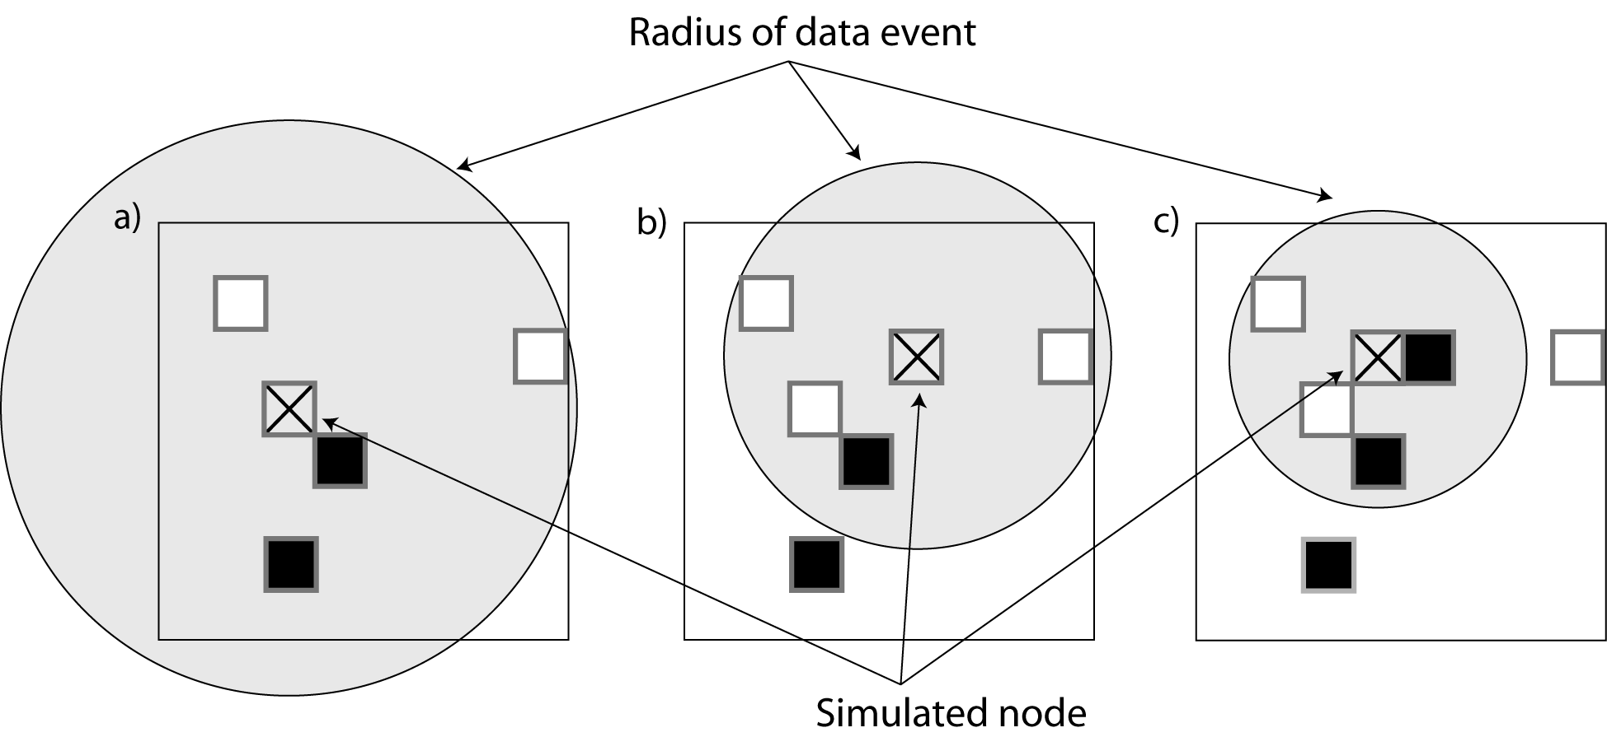
Definition of the data event
Data event constituted of the n closest nodes. Adapts automatically with the density of informed grid nodes.
Able to automatically represent multiple scales.

Slide 12
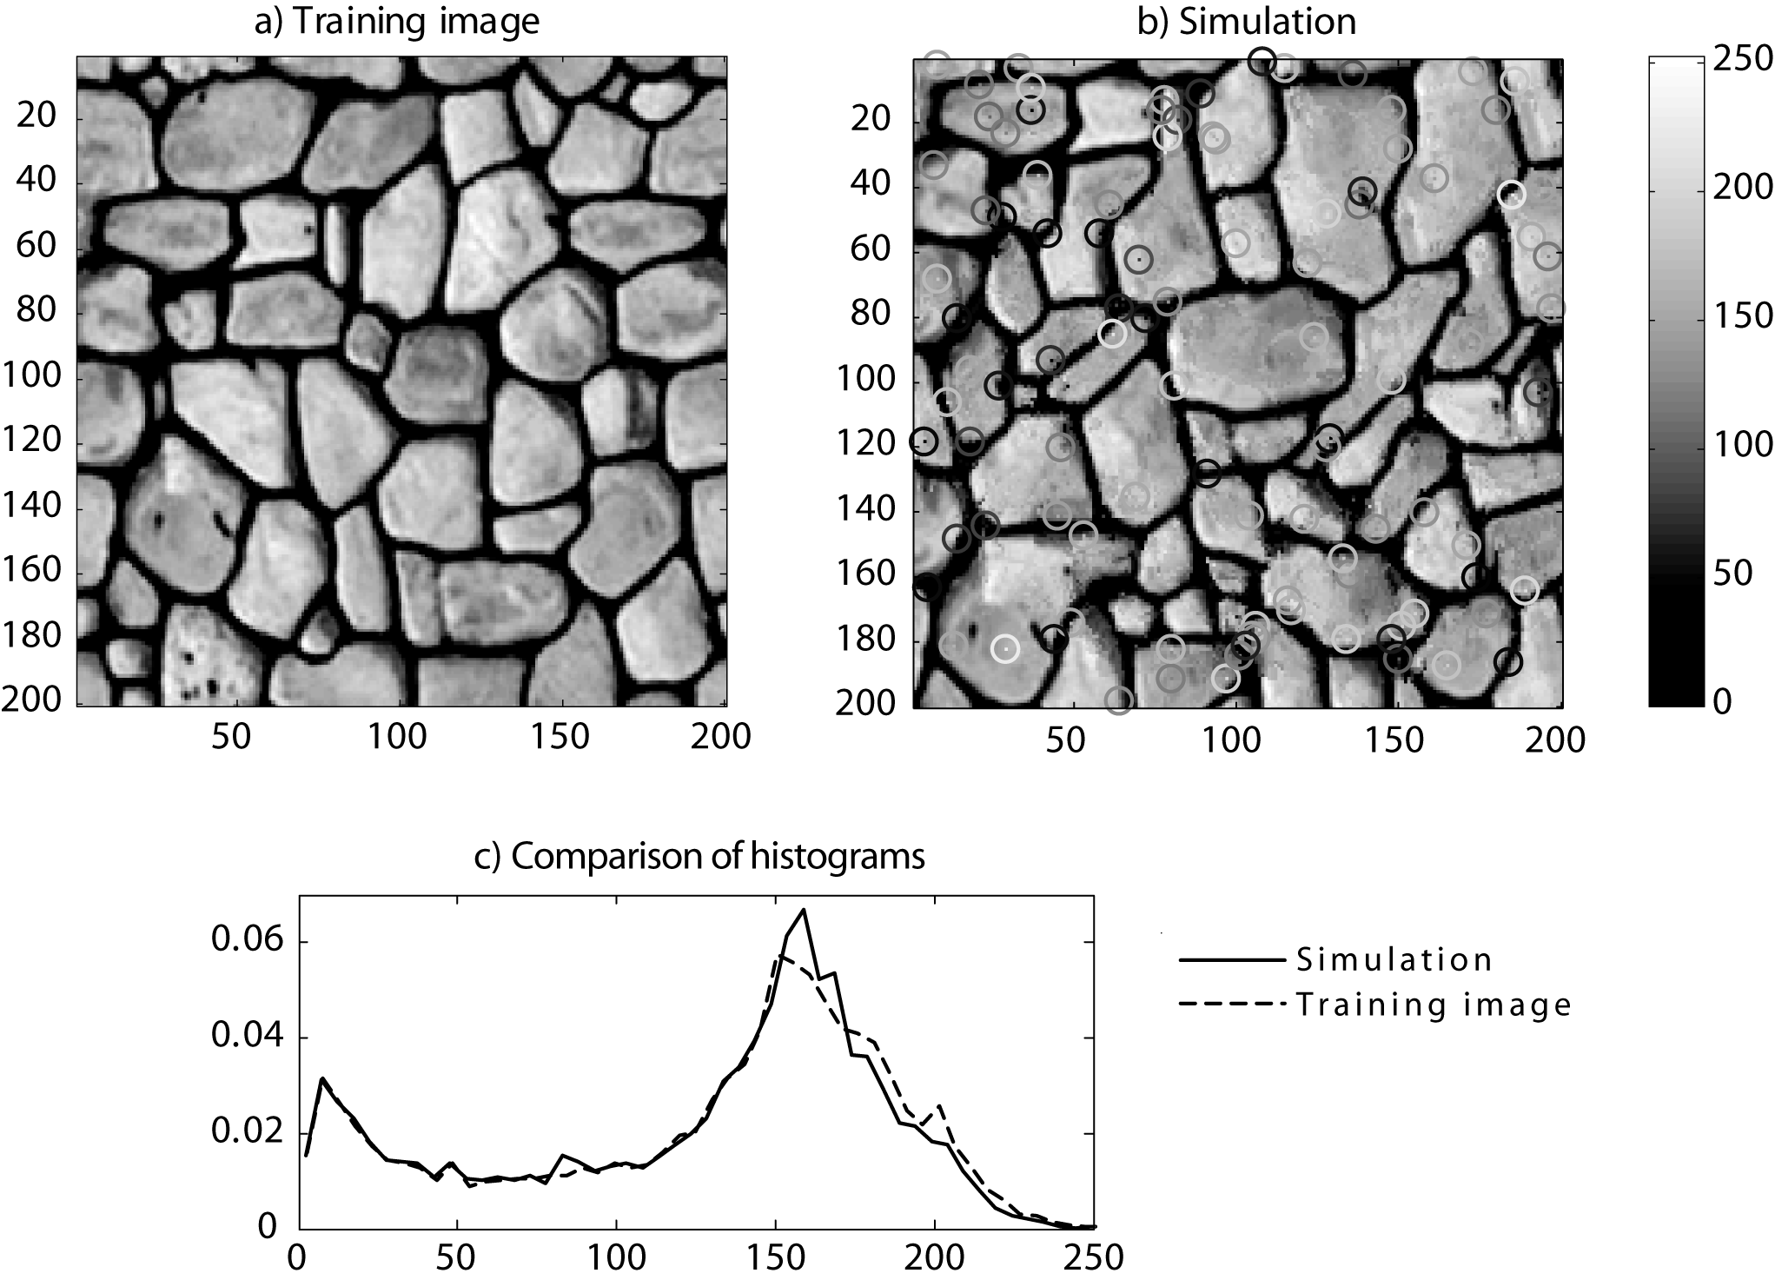
Can be used with continuous variable
Mariethoz, G., et al. (2010). "The direct sampling method to perform multiple-point geostatistical simulations." WRR 46(11).

Slide 13
Extension to multiple variables

Slide 14
The QS algorithm Used today - equivalent to DS but faster
Simulation
neighborhood
Training image
Matches !
Copy the value
Select randomly one of the k best candidates

Slide 15
The QS algorithm
For each simulated pixel, a full mismatch map is generated.
The k best matches are selected
One of these k matches is sampled
Gravey, M. and G. Mariethoz (2020). "QuickSampling v1.0: a robust and simplified pixel-based multiple-point simulation approach." Geosci. Model Dev. 13(6): 2611-2630.

Slide 16
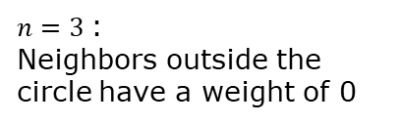
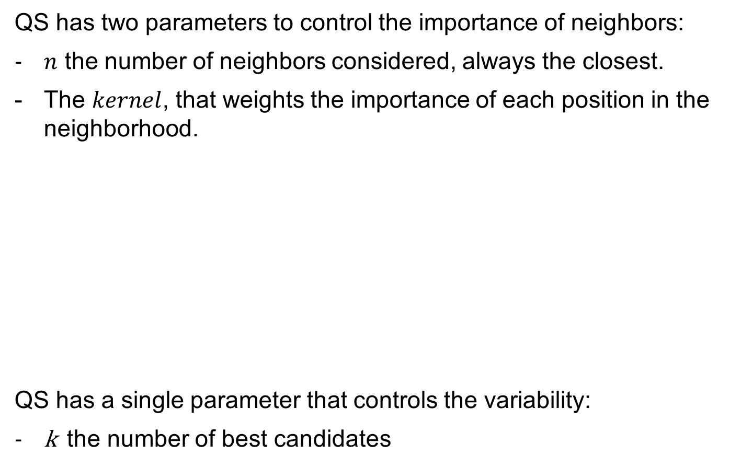
Parameters
QS has two parameters to control the importance of neighbors:
$n$ the number of neighbors considered, always the closest.
The $kernel$, that weights the importance of each position in the neighborhood.
QS has a single parameter that controls the variability:
k the number of best candidates
x0.5: kernel
$n=3$:
Neighbors outside the circle have a weight of 0
x2: kernel
x0.5: kernel

Slide 17
Sensitivity to k and n

Slide 18
Sensitivity to kernel

Slide 19
Some case studies

Slide 20
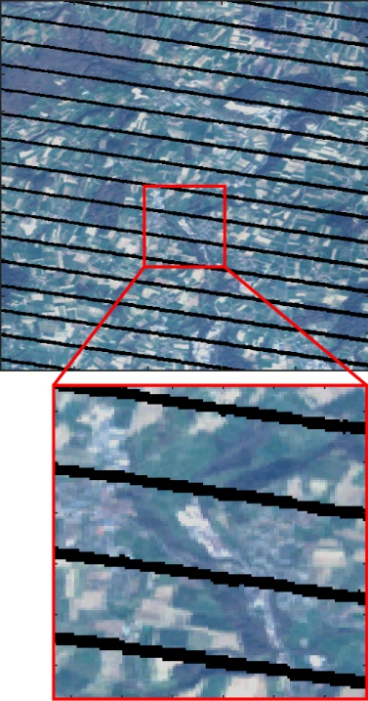
Satellite image gap-filling
Blue
Landsat-7: 15 years of continuous imaging with gaps.
Training image is the non-gap areas.
Quantification of the reconstruction uncertainty through multiple realizations.
Green
Red
Near IR
Short IR

Slide 21
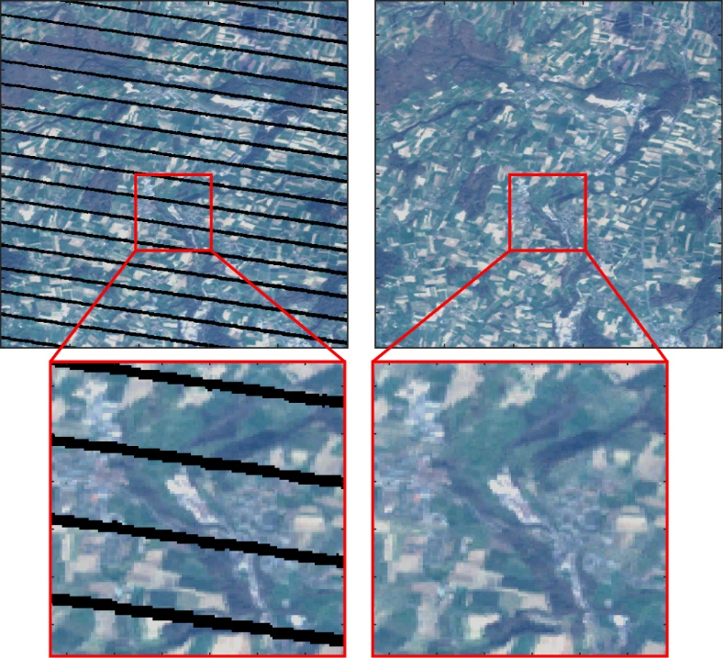
Application to Landsat 7 SLC-off images
Yin, G., et al. (2017). "Gap-filling of landsat 7 imagery using the direct sampling method." Remote Sensing 9(1).

Slide 22
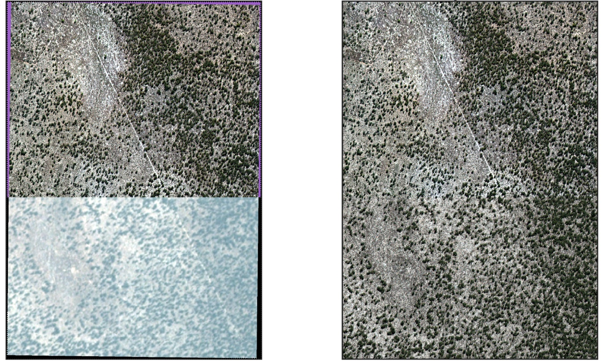
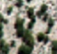

Downscaling satellite imagery
Lower portion of the image only known with low-quality sensor
Lower portion of the image reconstructed using MPS
Oriani, F., M. F. McCabe and G. Mariethoz (2021). "Downscaling Multispectral Satellite Images Without Colocated High-Resolution Data: A Stochastic Approach Based on Training Images." IEEE Trans. on Geo. Rem. Sen. 59(4): 3209-3225.

Slide 23
Time series simulation
Rainfall amount [mm]
Time [days]
Rainfall amount [mm]
Time [days]

Slide 24
Multivariate rainfall simulation
600
800
1000 days
Oriani, F., R. Mehrotra, G. Mariethoz, J. Straubhaar, A. Sharma and P. Renard (2018). "Simulating rainfall time-series: how to account for statistical variability at multiple scales?" Stochastic Environmental Research and Risk Assessment 32(2): 321-340.

Slide 25
Statistics of simulations
Annual seasonality
Alice Springs
Sydney
Wet day occurrence probability
Darwin
Mean daily rainfall [mm]
Daily rainfall standard deviation [mm]

Slide 26
Properties of MPS simulations
The texture is borrowed from an analogue.
The Generated patterns are non-smooth and texturally complex (i.e. patterns with sharp transitions, well-defined shapes and objects).
Reproduction of non-smooth features is quantified with texture metrics (spatial covariance, connectivity, coherence of classes).
Different stochastic realizations allow exploring uncertainty.

Slide 27
Conclusions
MPS can be useful when one needs to generate complex patterns, and at the same time large amounts of analogue data are available elsewhere (=prior information).
Challenges remain regarding the source of training images, the parameterization of simulation algorithms, and in some cases computing cost.
Other applications exist, e.g. downscaling, weather generation, data fusion, 3D subsurface models.
Open-source code here: https://github.com/GAIA-UNIL/G2S

Slide 28
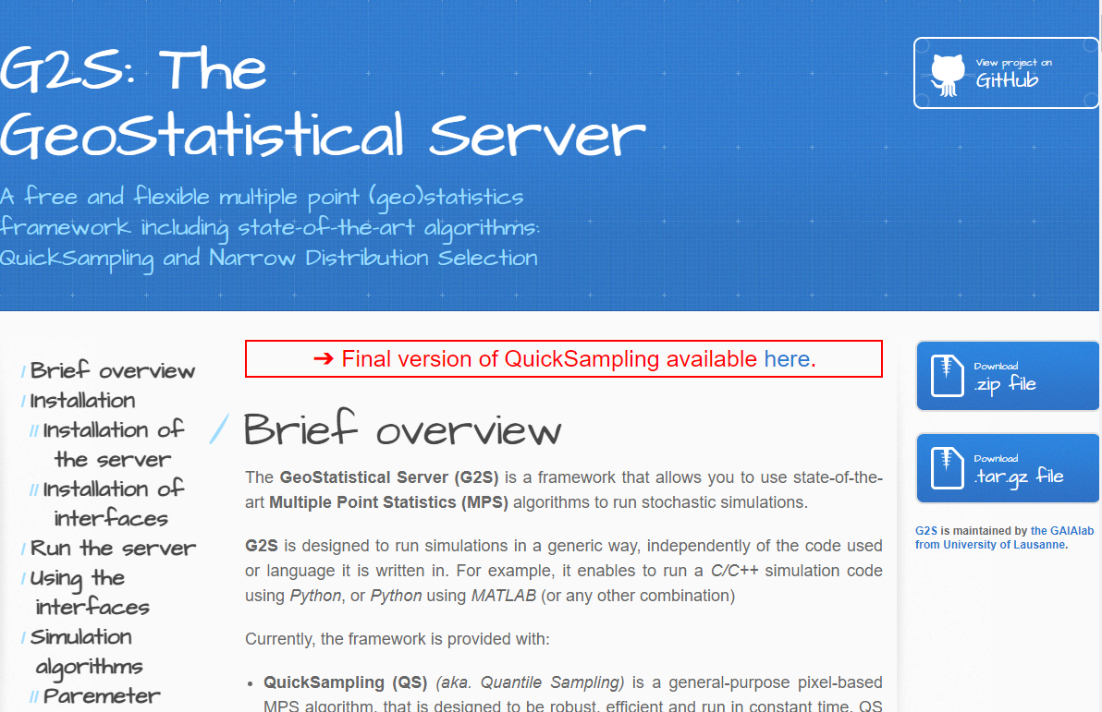
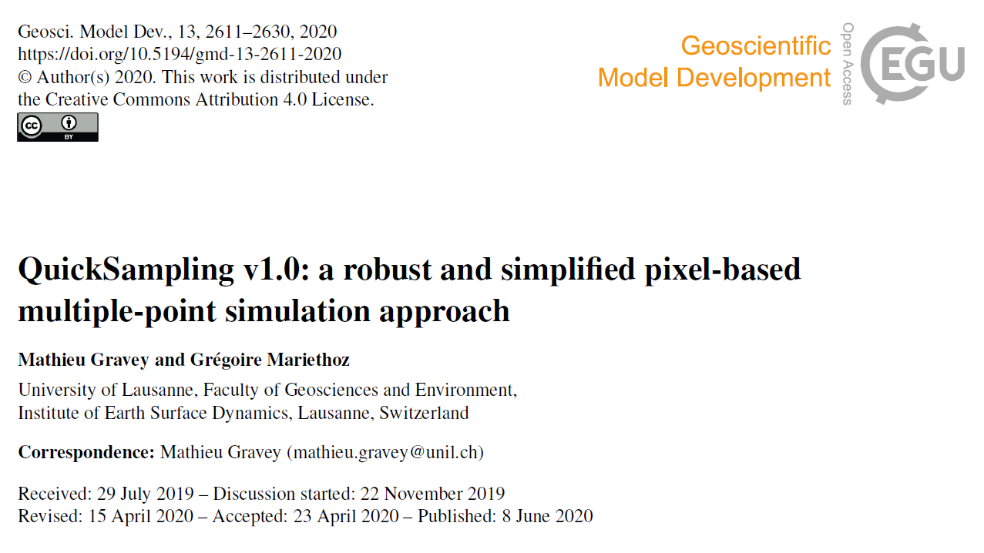
https://gaia-unil.github.io/G2S/
https://gmd.copernicus.org/articles/13/2611/2020/

Slide 29
Thank you
Questions?

